Slide 1
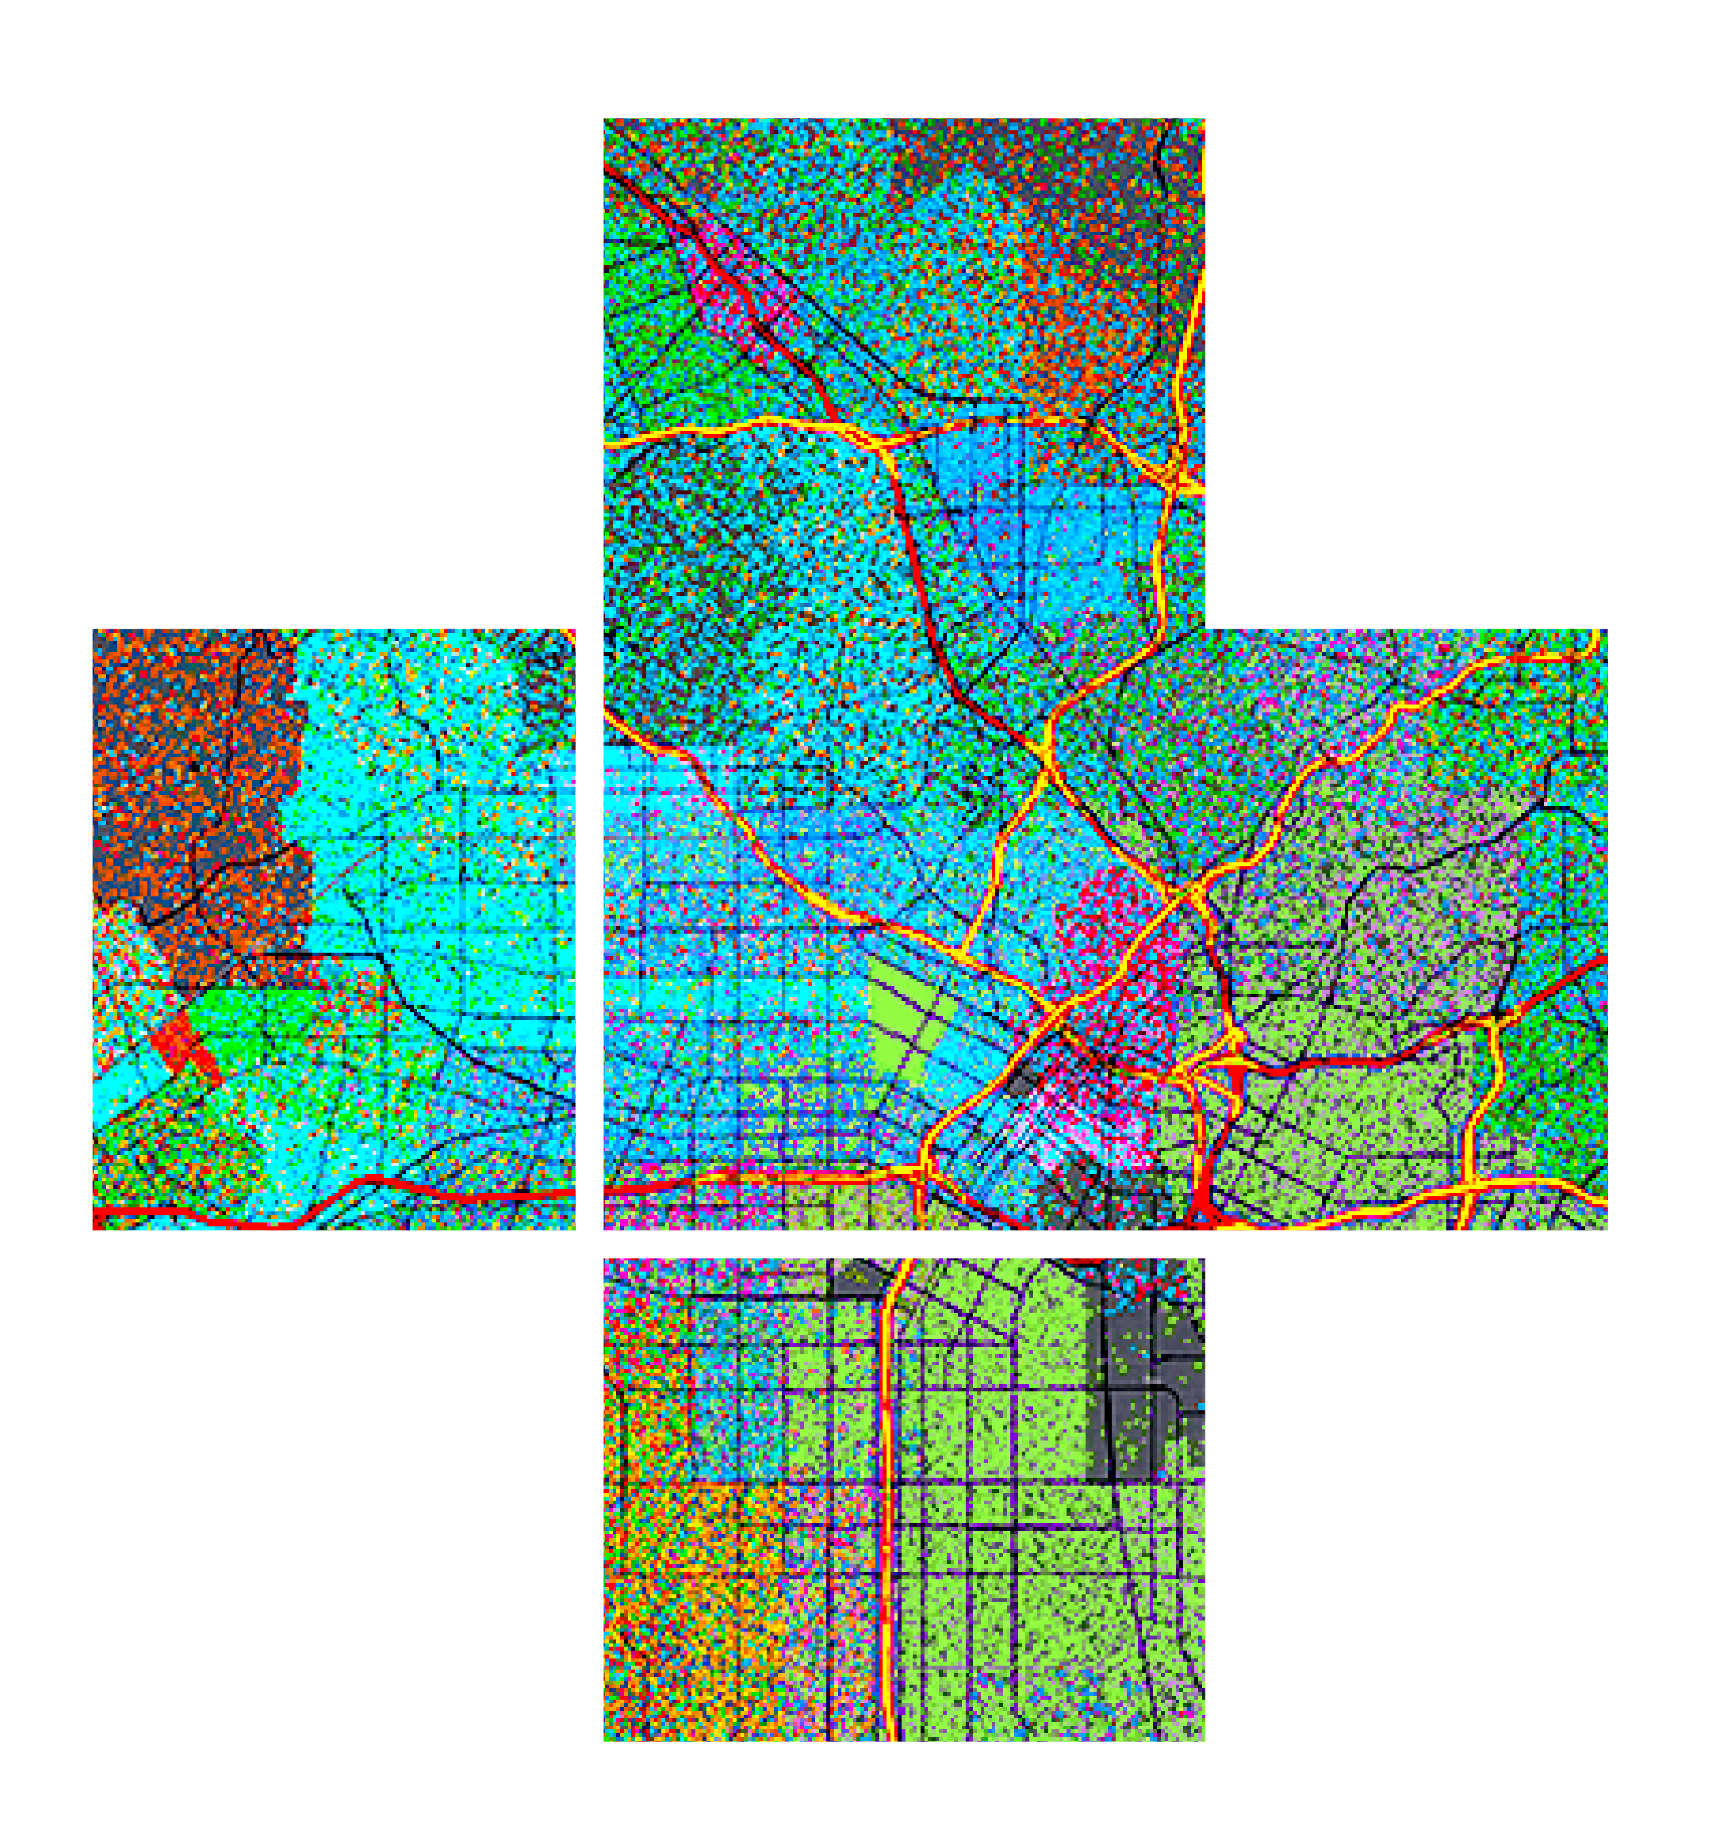








Best practices for building web apps that visualize large datasets
Please leave artwork “+” clustered.
Do not use them alone, as bullet points, or as a “plus” concept. Thank you.
Jeremy Bartley & Kristian Ekenes
2020 ESRI DEVELOPER SUMMIT | Palm Springs, CA

Slide 2


Overview
Initial considerations
What the JS API and ArcGIS platform do for you
Optimizing your apps and data for better performance
Visualization Techniques
Scale-dependent filtering
Clustering
Data prep/processing
Reducing/generalizing features and attributes
Aggregation
Notes:
Show the playground here

Slide 3


Considerations before you start development
Jeremy Bartley

Slide 4
Considerations before you start development
Know your audience
Just a few specialized users?
Public or private?
Potential to go viral?
Devices
Desktop only?
Mobile and tablets
Generalization
Choose an appropriate geometry type for scale
Reduce number of features
Reduce vertices
Notes:
Show the playground here

Slide 5
Behind the scenes
What the JS API & ArcGIS platform do for you

Slide 6
Feature Tiles
Efficient, flexible, and scalable way to bring data
to the client

Slide 7
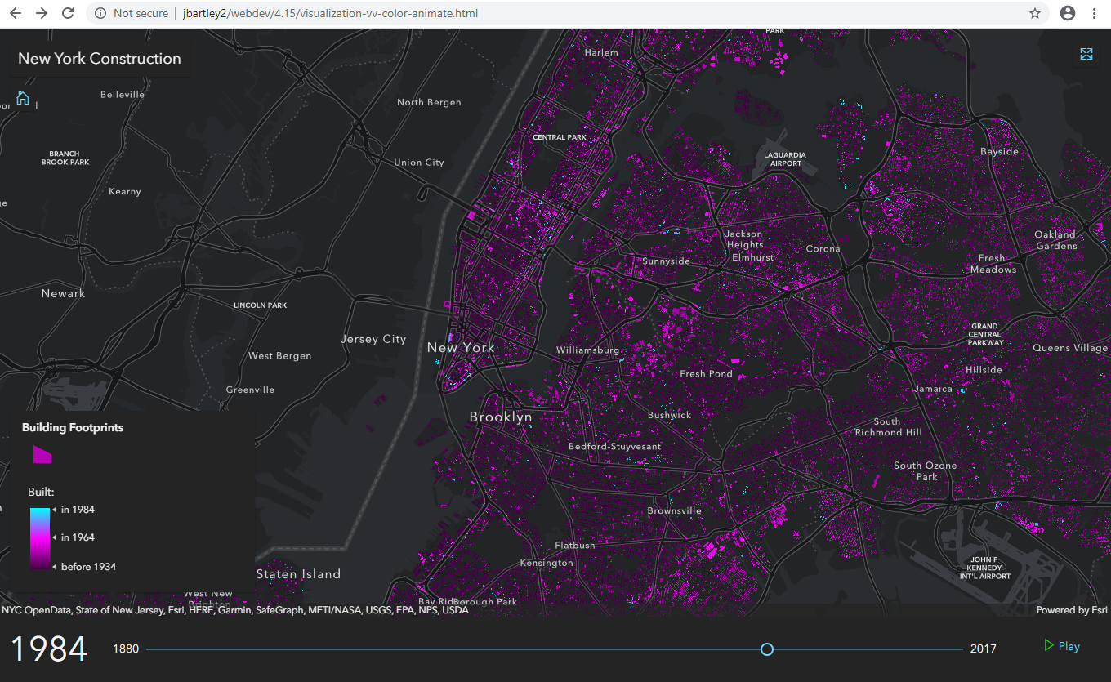
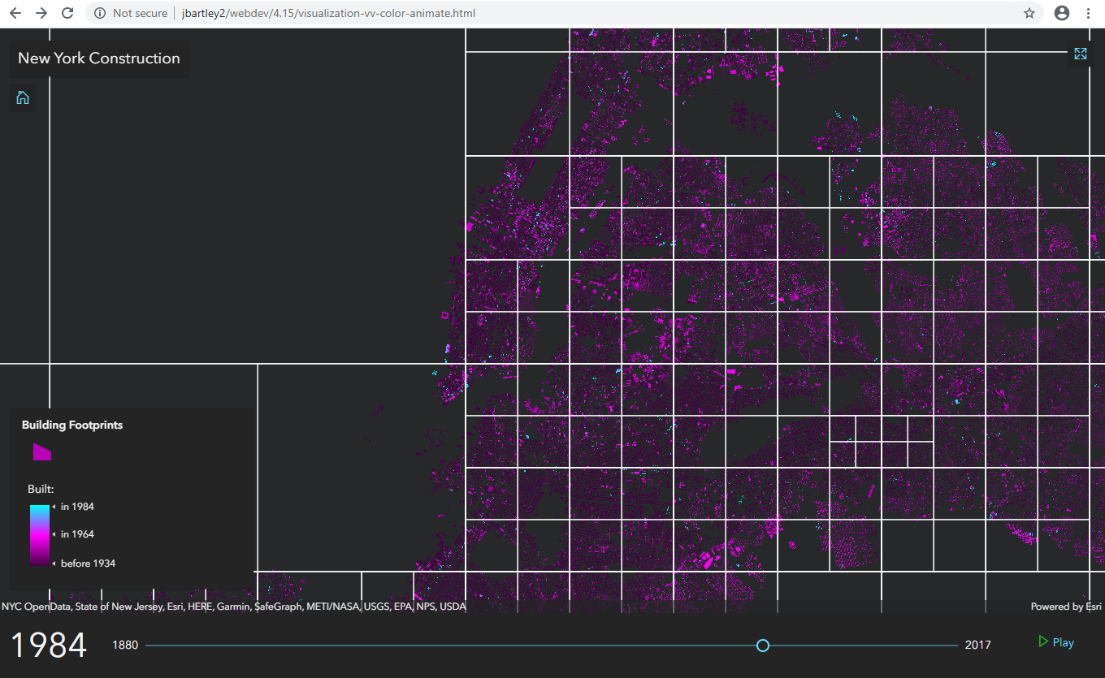
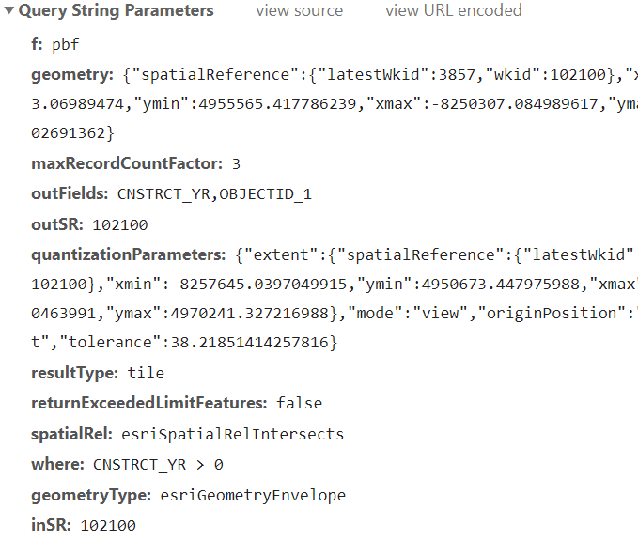
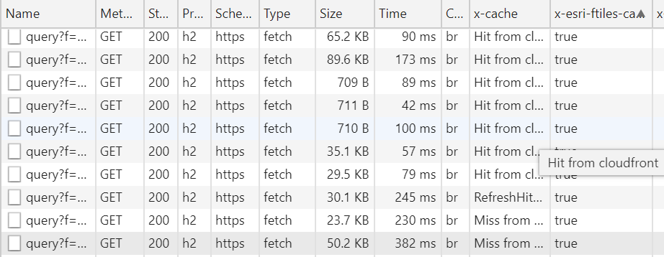
941,874 polygons
drawn on the view
Query for data one tile
at a time

Slide 8
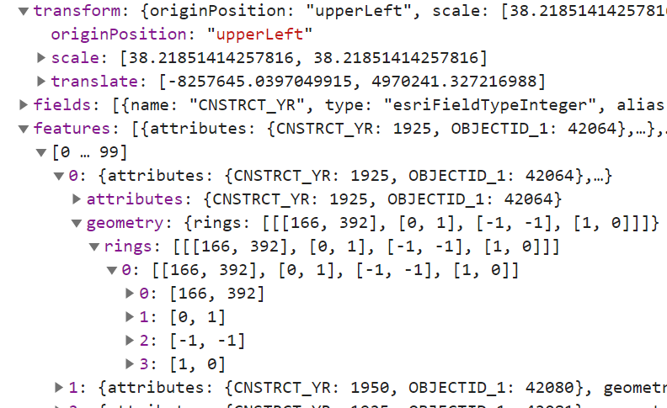
Data structure returned from feature tile query is highly efficient

Slide 9

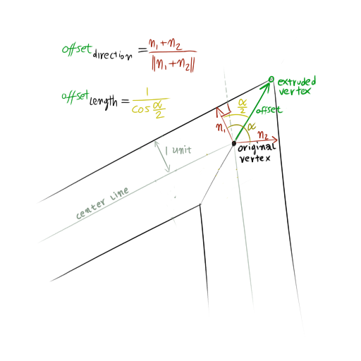
Efficiently process and prepare features to be drawn on the graphics card

Slide 10
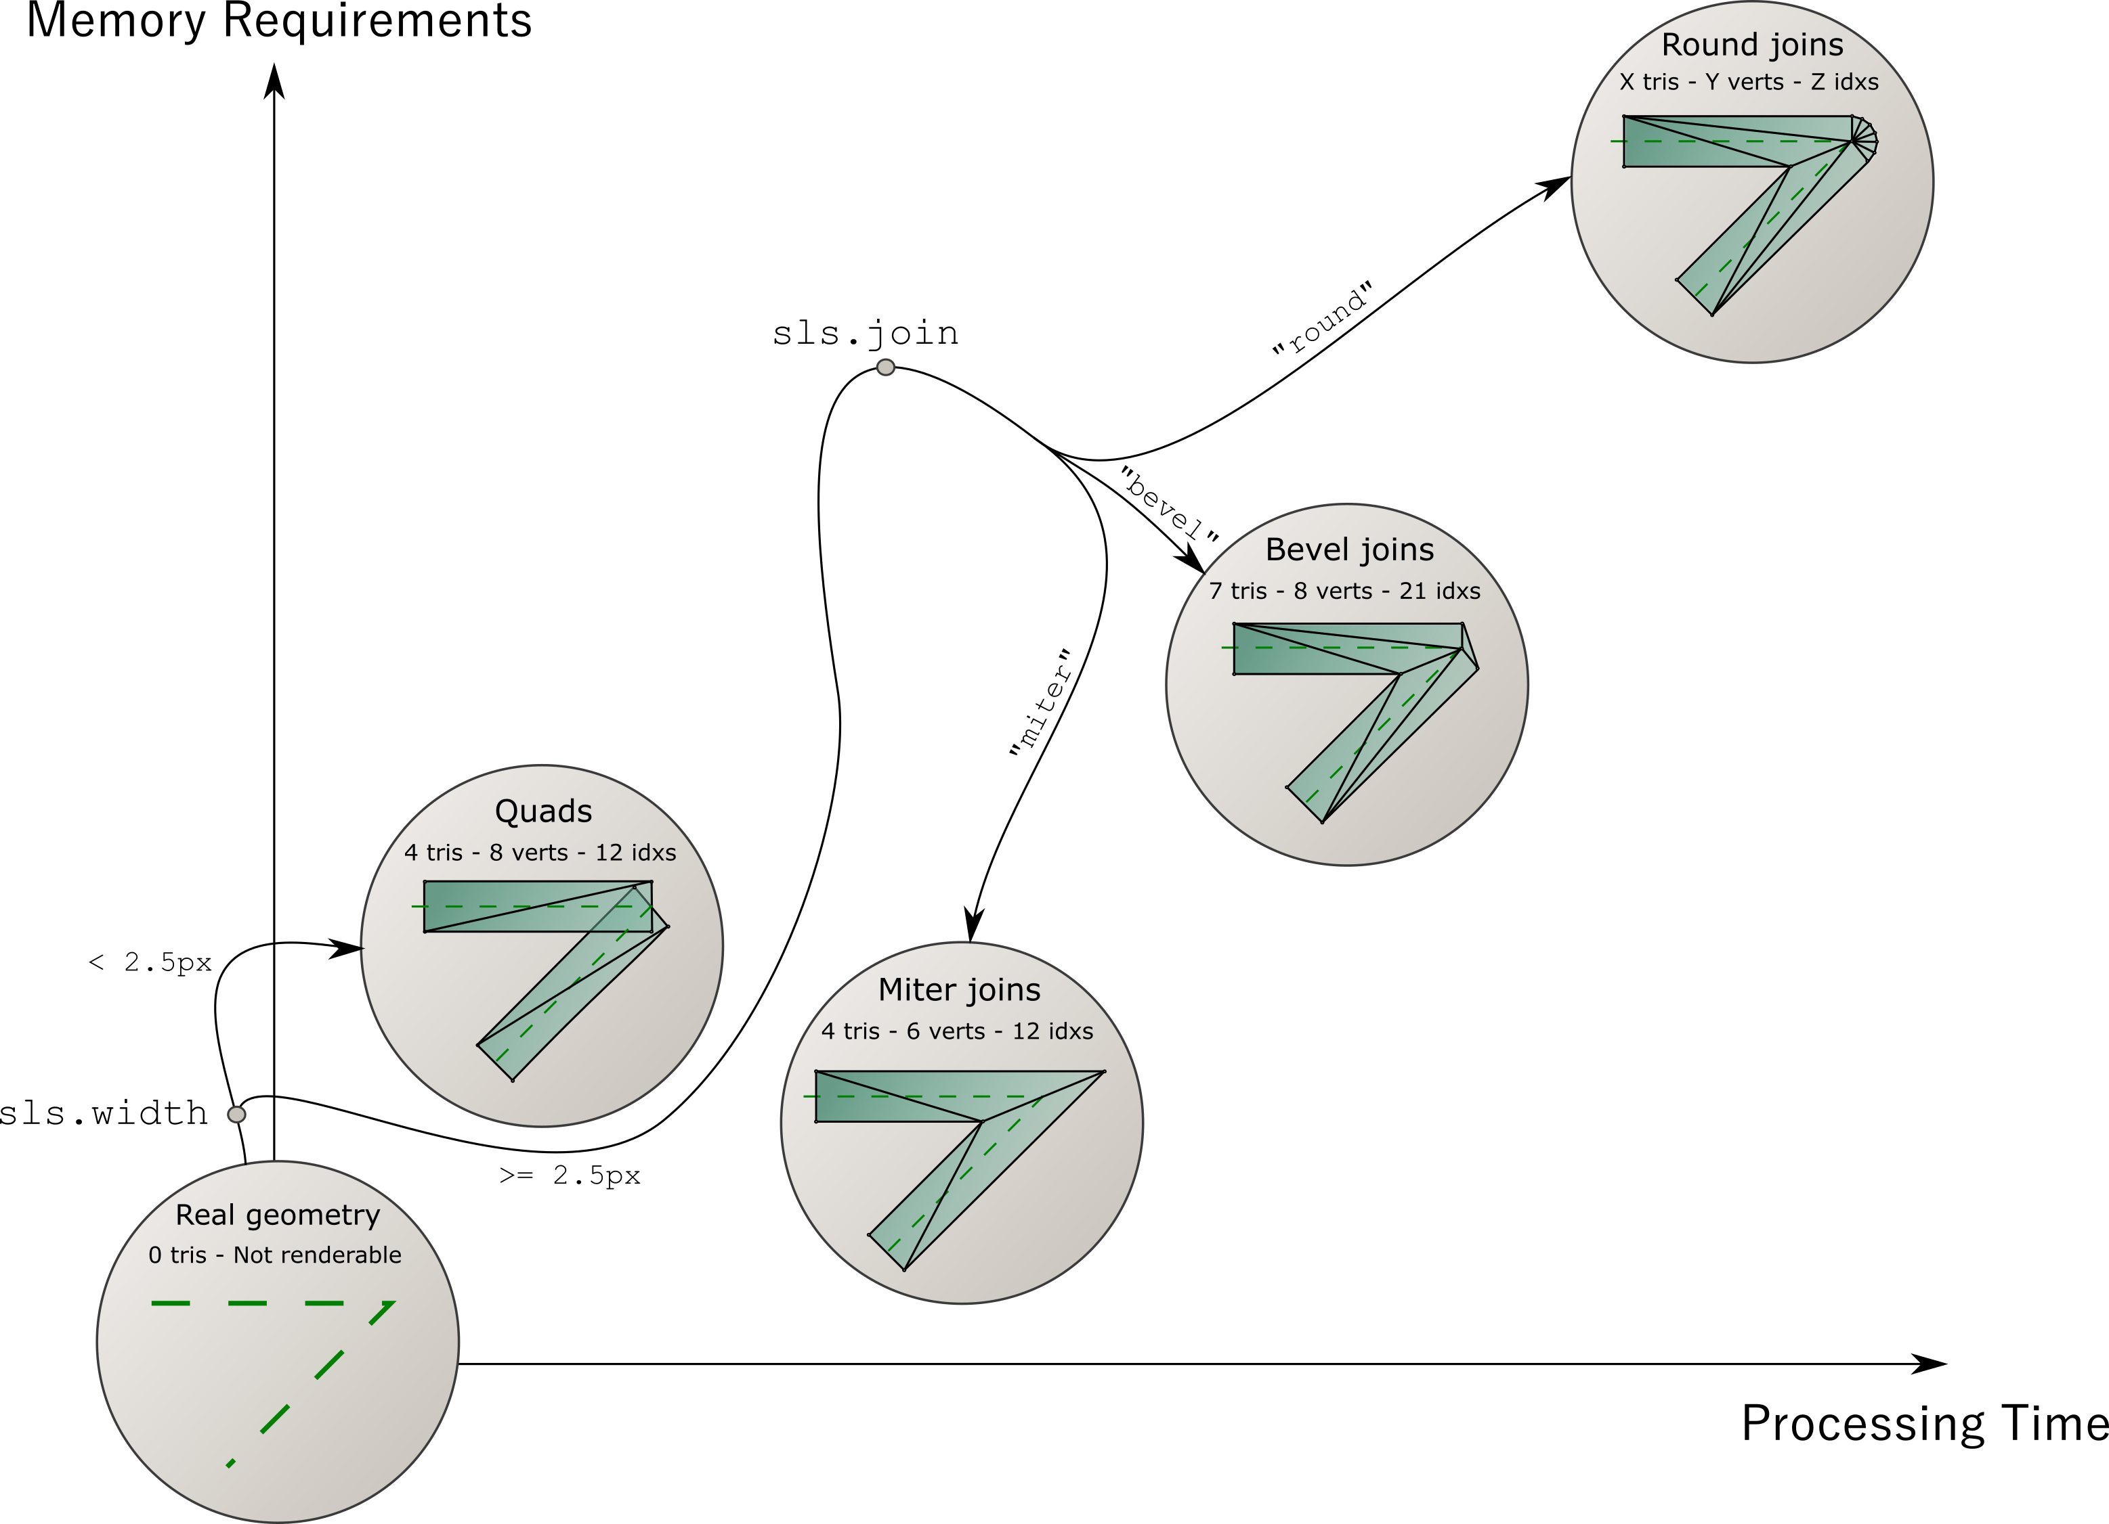
Line optimizations: balancing display quality with overall performance

Slide 11
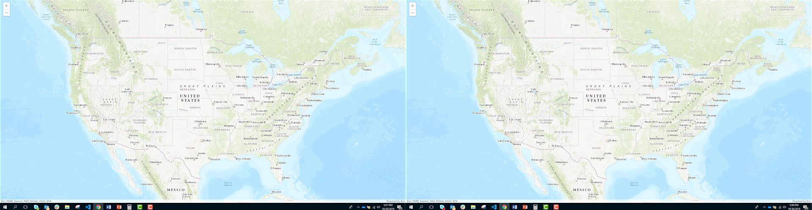
Feature layer performance has improved over the last year
30,696 zip code polygons: 32.8% faster load
Improvements to speed, accuracy and memory profile
Improved triangulation processing
Faster lines
4.9
4.13

Slide 12
Visualization techniques
Scale-dependent filtering

Slide 13
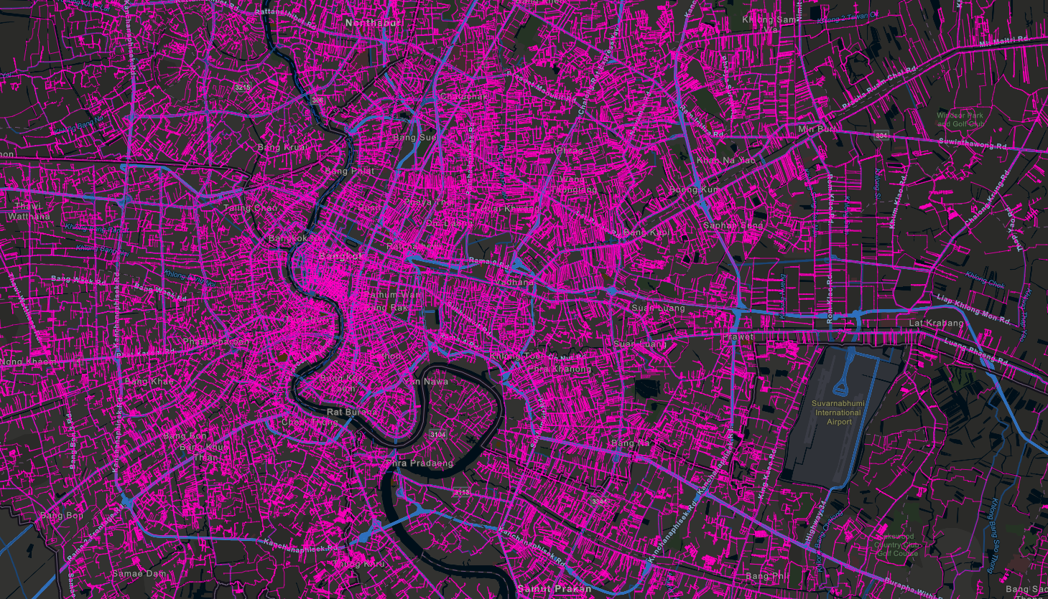


Water distribution pipes

Slide 14
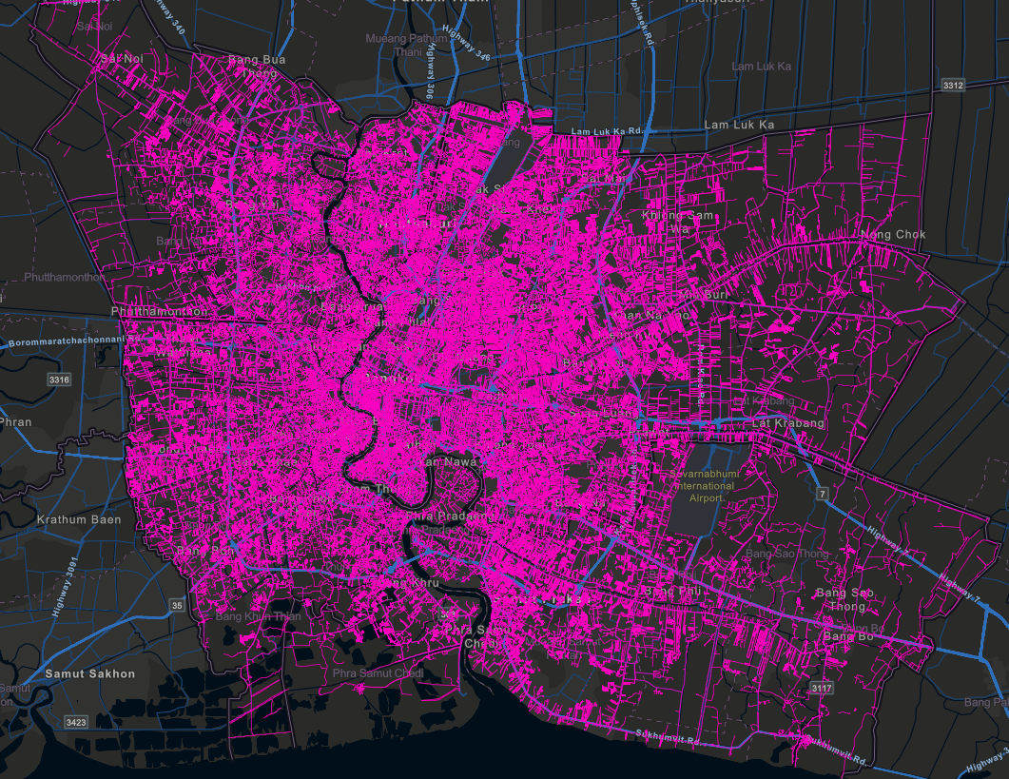
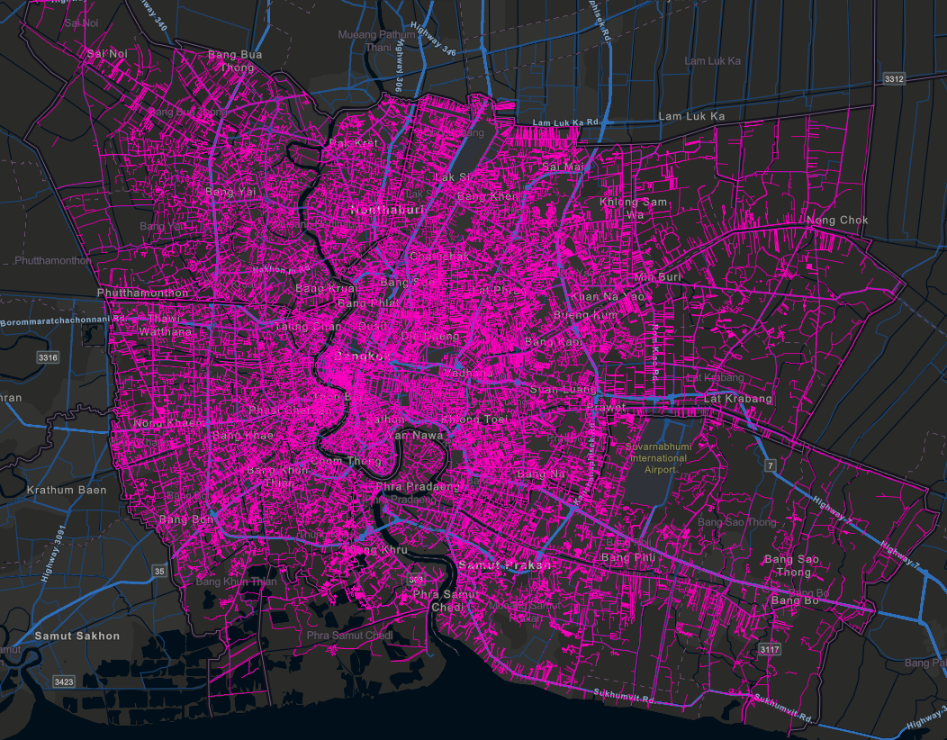
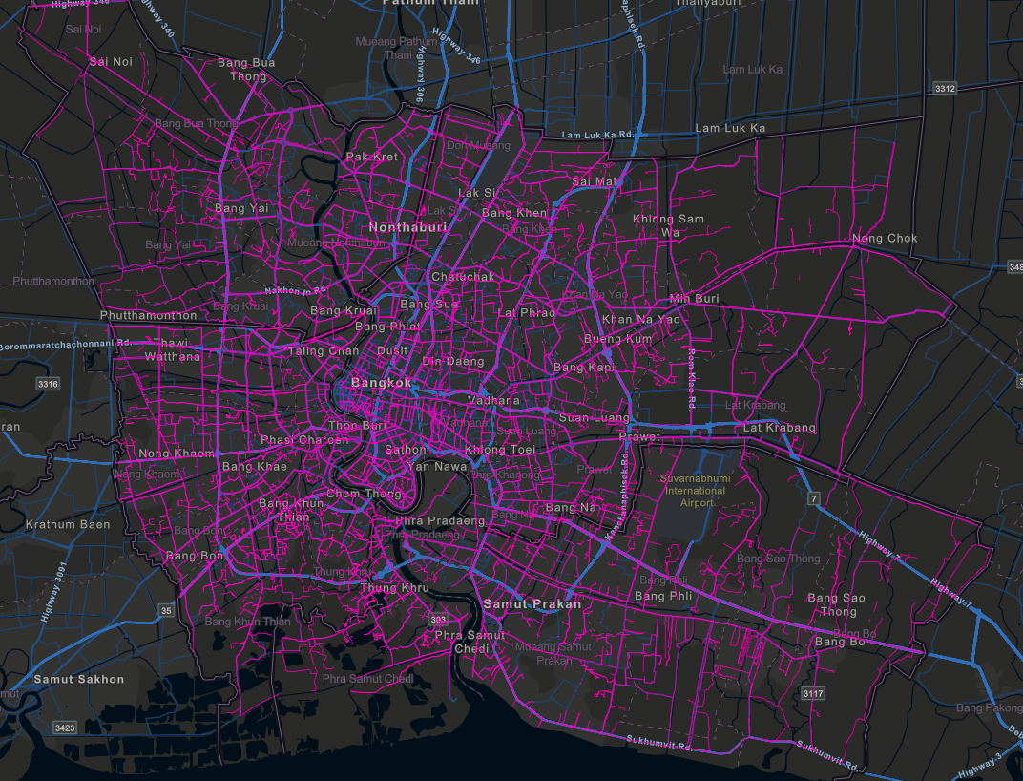
Filter by scale using attributes
No filter
17.7 MB (uncompressed)
~7s (desktop on fast network)
Filter: pipe_size >= 150
14.7 MB (uncompressed)
~5s (desktop on fast network)
Filter: pipe_size >= 300
11.2 MB (uncompressed)
~3s (desktop on fast network)
550,578 features
358,921 features
Still 107,256 features!
Notes:
Show the playground here

Slide 15
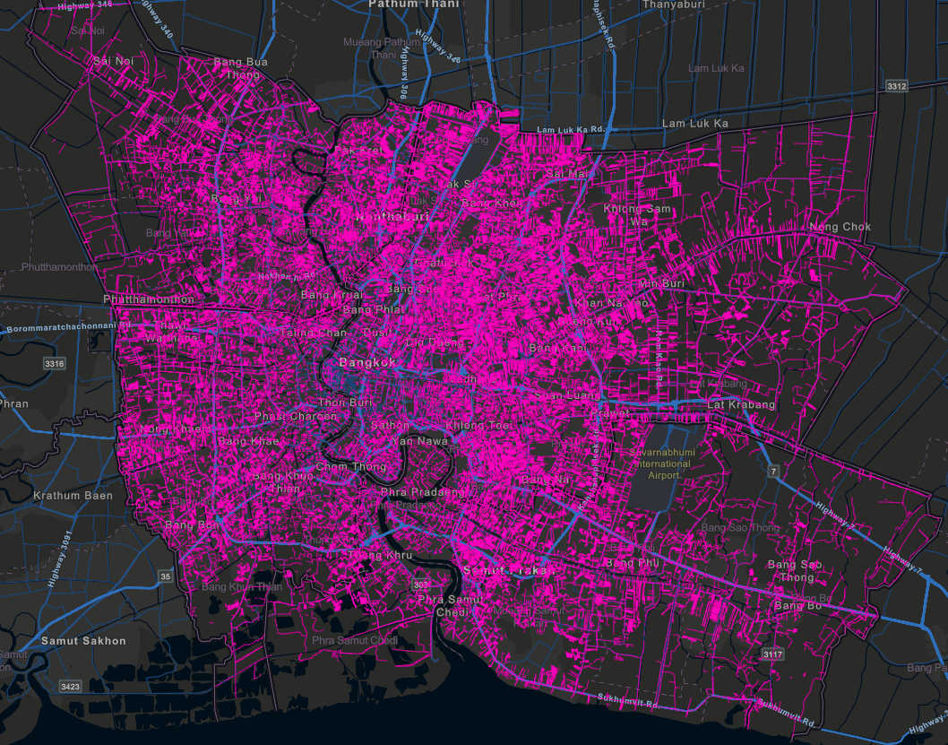
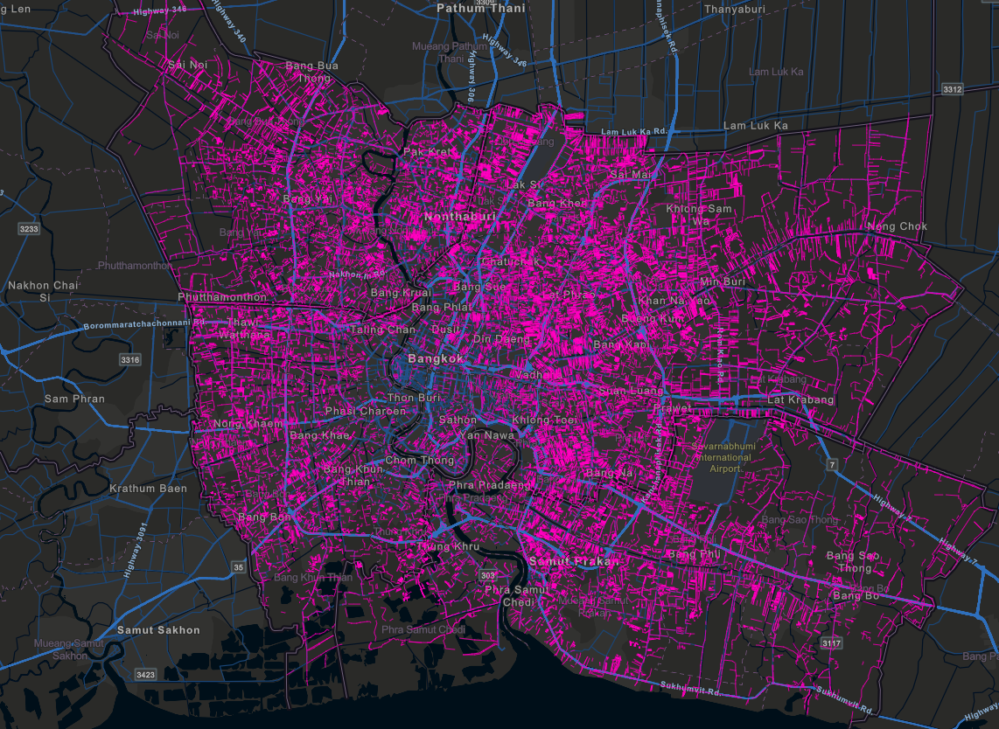
Filter by scale using view resolution
view.resolution * 2
11.2 MB (uncompressed)
~3s (desktop on fast network)
view.resolution * 3
10.5 MB (uncompressed)
~2.8s (desktop on fast network)
No filter
17.7 MB (uncompressed)
~7s (desktop on fast network)
550,578 features
Only 62,313 features!
30,316 features!
Notes:
Show the playground here

Slide 16
Visualization techniques
Clustering

Slide 17
Data prep and processing
Working with different geometry types

Slide 18
Data prep and processing
Thinning geometries and attributes

Slide 19
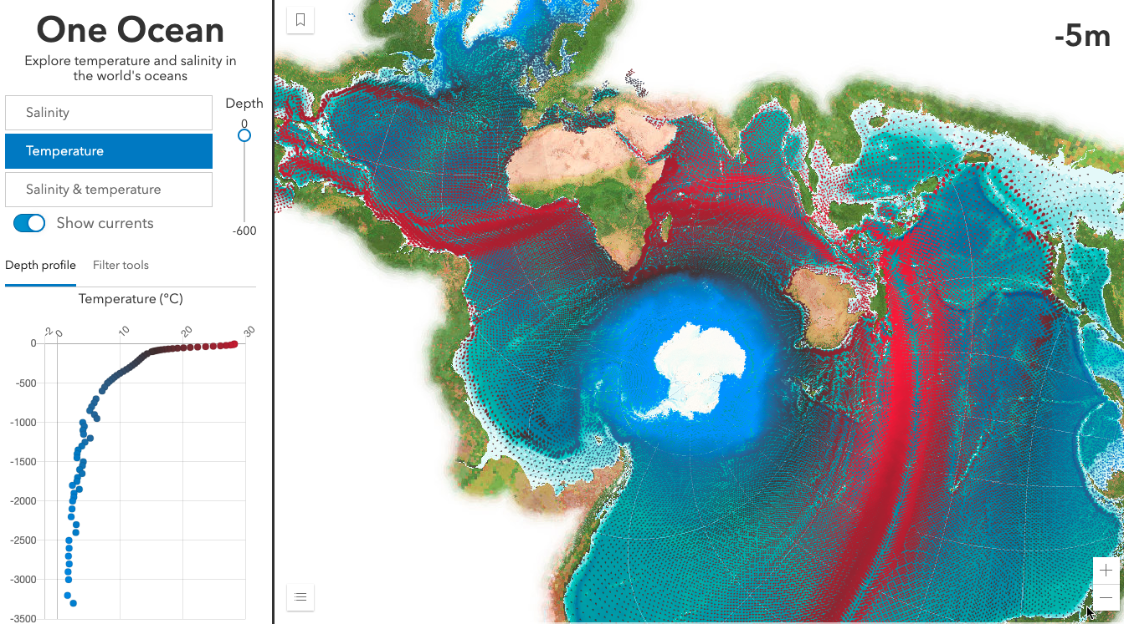
One Ocean
Kristian Ekenes

Slide 20
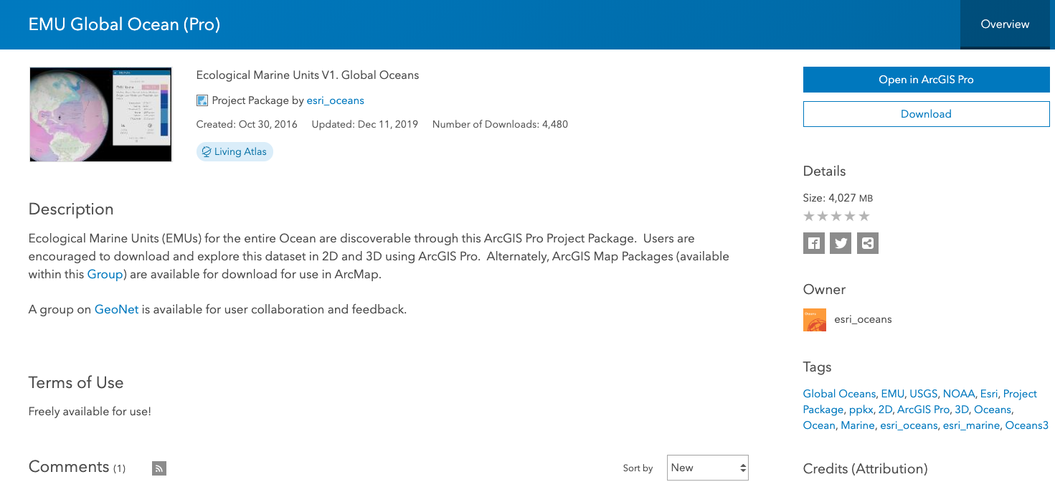

Notes:
Show the playground here

Slide 21
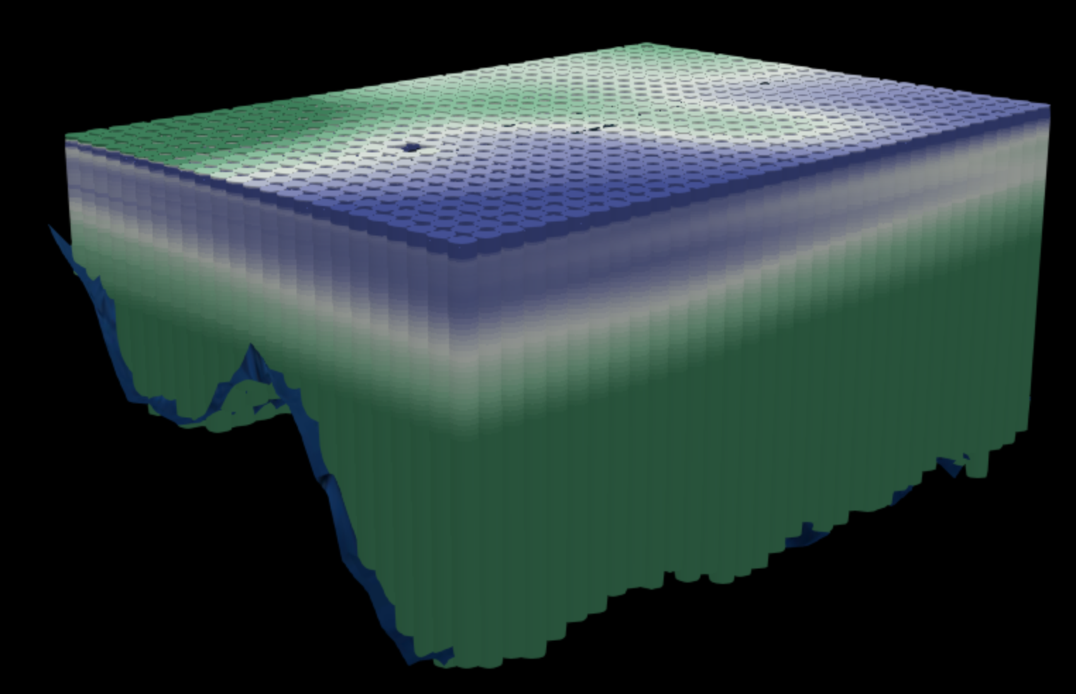

Goal: get the total download as small as possible
Know your data!
52 million points!
> 4 GB of data
Points at every ¼ degree of lat/lon
Up to 102 points stacked at each location (from surface to ~5,000m depth)
12 attributes per point (temperature, salinity, phosphate, silicates, EMU cluster, etc.)
Notes:
Show the playground here

Slide 22
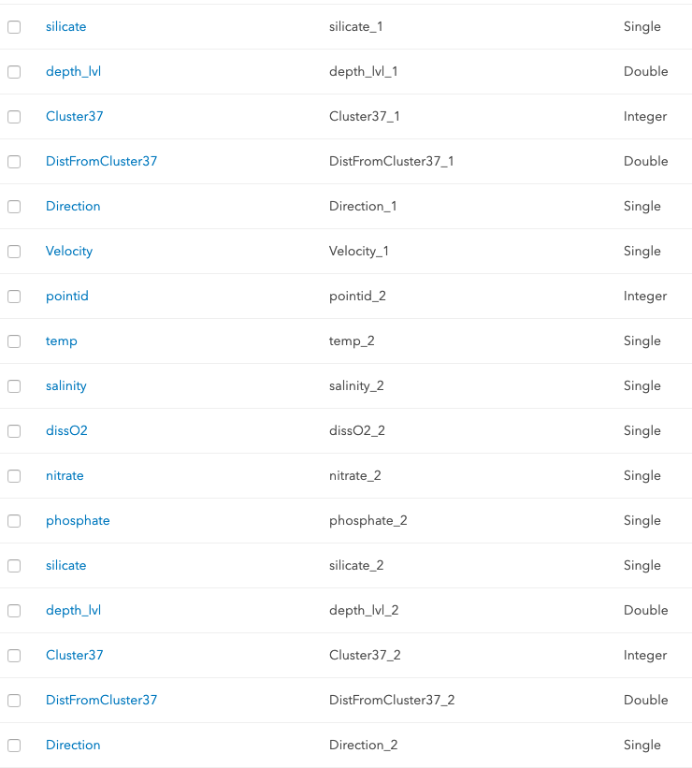
Goal: get the total download as small as possible
Step 1: Generalization
One point per x,y location
Flatten the table
spatial join or
table pivot
Reduced number of points to 677,109 features. Data is now one row per x,y location with fields for each attribute at each depth level.
New problem – Now we have 1,224 fields.
Notes:
Show the playground here

Slide 23
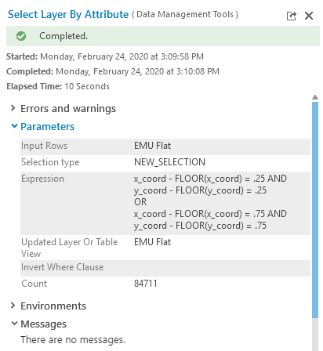
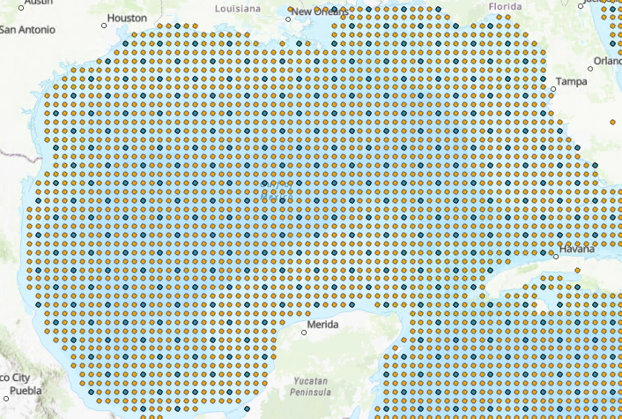
Goal: get the total download as small as possible
Step 2: Generalization
Geometry thinning
Thin points to every ½ degree ( ¼ degree resolution is too high for worldwide views)
Reduced number of points to 84,711 features! A reasonable number to work with.
Notes:
Show the playground here

Slide 24
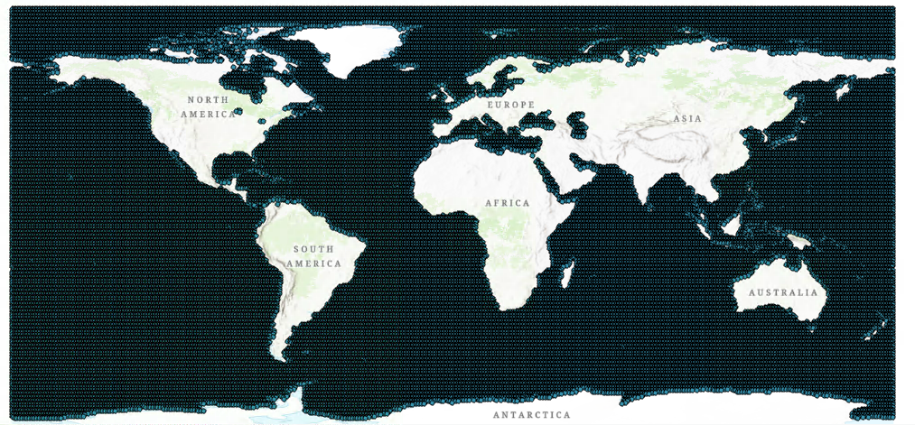
Goal: get the total download as small as possible
Notes:
Show the playground here

Slide 25
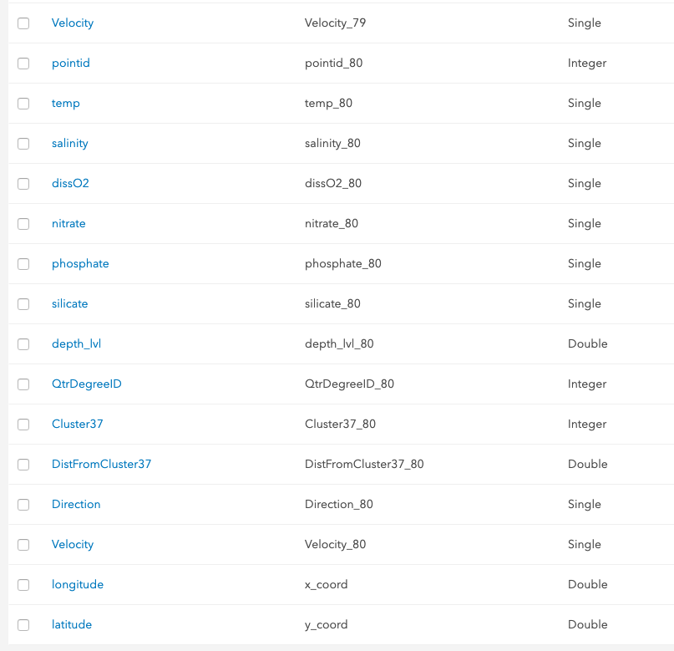
Goal: get the total download as small as possible
Step 3: Reduce columns
Attribute thinning
Feature Services limit you to 1,024 fields.
I removed ~300 fields and was able to publish the service.
Remaining problems:
960 fields is still too much data to work with on the client.
Setting outFields to one attribute for every depth level results in huge query string requiring the POST method (not cacheable)
Notes:
Show the playground here

Slide 26
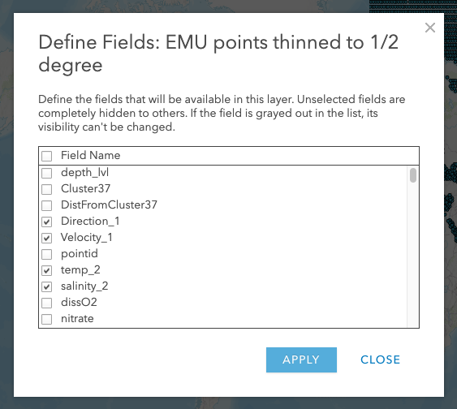
Goal: get the total download as small as possible
Step 3: Reduce columns
Attribute thinning
Create hosted Feature View and restrict fields to only the ones you need.
Now we have ~300 fields (useable)
Queries can request outFields using [“*”], which can be cached.
Set maxAge on tiles to 1 hour.
Now we have a manageable dataset we can work with in the browser!
Notes:
Show the playground here

Slide 27
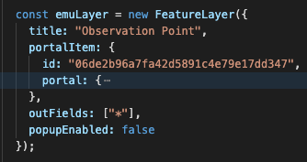
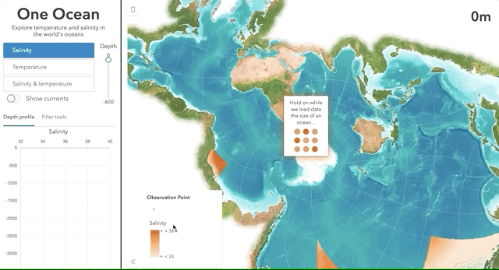
Goal: get the total download as small as possible
Step 4: Request data up front
For client-side goodness
Now we have a manageable dataset we can work with in the browser!
Costs:
Still loads 280 MB of data!
Not useable for mobile devices
Initial load time is longer, but…
UX is a lot nicer once the data loads.
Notes:
Show the playground here

Slide 28
Conclusion
The ArcGIS platform does a lot behind the scenes to optimize your data and apps when loading large abounts of data, but
YOU can do more to optimize your apps and data for better performance
Visualization Techniques
Scale-dependent filtering
Clustering
Data prep/processing
Reducing/generalizing features and attributes
Aggregation
Notes:
Show the playground here

Slide 29


